Slide 1
Mobile E Commerce
Submitted By:
Jasleen Kaur
90370305174
95132

Slide 2
About the project
Project Name | Mobile E commerce
Company | One Infonet Technologies
Project Type | Mobile Application
Front End | Android
Back End | MySql
Middle Tier | JSP

Slide 3
Module Details
Mobile E commerce is an android application with Android as front end, JSP as the middle Tier and MySQL as data store.
It has four types of users- Administrator, Supplier, Wholesaler, Retailer. Every retailer and supplier has his own virtual shop
Admin End- He is the owner of the app. He is responsible for complaint management, category management, user management, price management

Slide 4
Module Details(Continued)
The supplier is any business owner who wants to sell items in bulk. He can add items, buy advertisement, subscribe/ unsubscribe categories, add categories, order management, warehouse management.
The retailer is any business owner who purchases items from the supplier and sells them at a small discount.
The customer is any person who wants to do some online shopping. He can add items to the shopping cart or save them to his wishlist.

Slide 5
Module details continued
Login: To enter the system the user or admin have to enter their unique username and password assigned to them.
New user: When a new user wants to access the system, he is given a user form to fill. On submission of the credentials in the form his data goes to the database
Dynamic Selection: The user has to specify his search query and category specifications of the products he wishes to buy and the system produces a dynamic page according to his needs from which he can choose any item
Cart: After selecting the item and specifying his quantity the item is to be added to the cart. From this cart the user may delete or update his selection.

Slide 6
What is Android
Android is a Linux-based operating system designed primarily for touchscreen mobile devices such as smartphones and tablet computers. Initially developed by Android, Inc., which Google backed financially and later bought in 2005, Android was unveiled in 2007 along with the founding of the Open Handset Alliance: a consortium of hardware, software, and telecommunication companies devoted to advancing open standards for mobile devices.The first Android-powered phone was sold in October 2008.
Android is open source and Google releases the code under the Apache License. This open source code and permissive licensing allows the software to be freely modified and distributed by device manufacturers, wireless carriers and enthusiast developers. Additionally, Android has a large community of developers writing applications ("apps") that extend the functionality of devices, written primarily in a customized version of the Java programming language. In October 2012, there were approximately 700,000 apps available for Android, and the estimated number of applications downloaded from Google Play, Android's primary app store, was 25 billion.

Slide 7
Parts of android
An activity represents the visual representation of an Android application. activities use views, i.e. user interface widgets as for example buttons and fragments to create the user interface and to interact with the user.An Android application can have several activities.
Fragments are components which run in the context of an activity. A fragment encapsulates application code so that it is easier to reuse it and to support different sized devices. Fragments are optional components which allow you to reuse user interface and non user interface components for different devices configurations.

Slide 8
Parts of android continued
Views are user interface widgets, e.g. buttons or text fields. The base class for all views is the android.view.Viewclass. Views have attributes which can be used to configure their appearance and behavior.
A layout manager is responsible for arranging other views. The base class for these layout managers is theandroid.view.ViewGroup class which extends the View class.

Slide 9
Parts of android Continued
Intents are asynchronous messages which allow the application to request functionality from other Android components, e.g. from services or activities. An application can call a component directly (explicit Intent) or ask the Android system to evaluate registered components based on the intent data (implicit intents). For example the application could implement sharing of data via an intent and all components which allow sharing of data would be available for the user to select. Applications register themselves to an intent via an intent filter. Intents allow an Android application to start and to interact with components from other Android applications.
Services perform tasks without providing a user interface. They can communicate with other Android components and notify the user via the notification framework in Android.
Broadcast receivers can be registered to receive system messages and intents. A broadcast receiver gets notified by the Android system, if the specified event occurs. For example you can register a broadcast receivers for the event that the Android system completed the boot processor or for the event that the state of the phone changes, e.g. someone is calling.

Slide 10
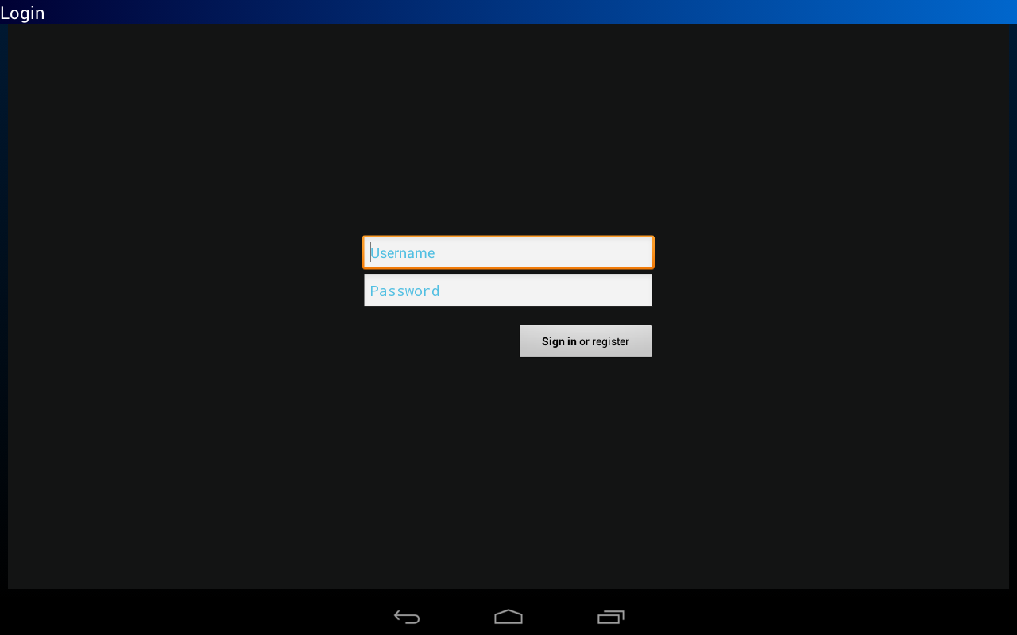
Login Screen

Slide 11
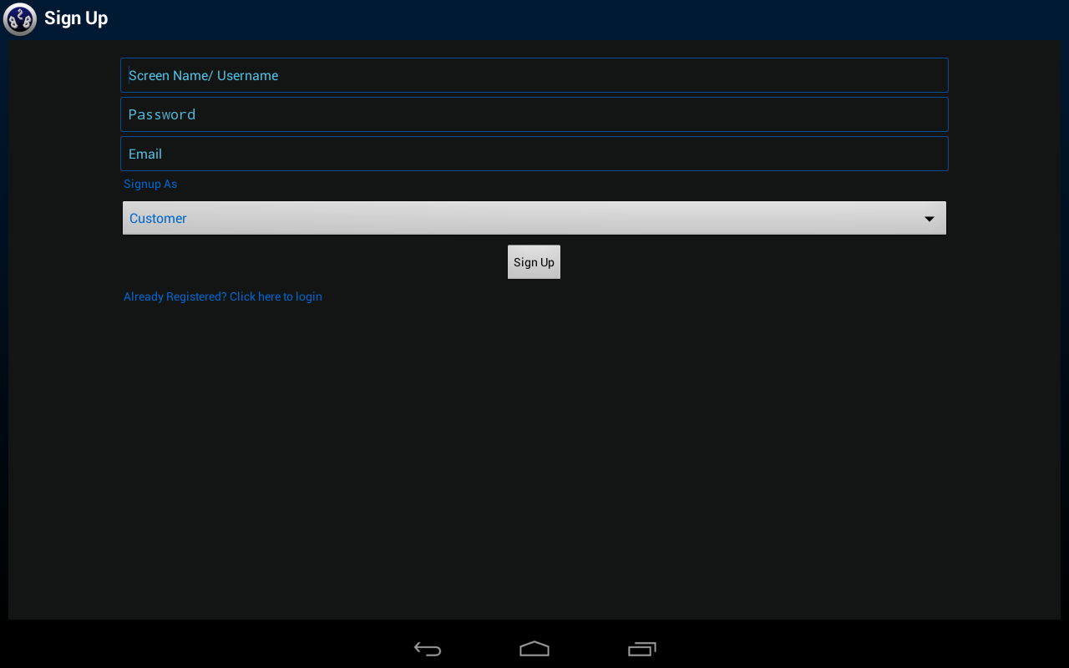
Registration Screen

Slide 12
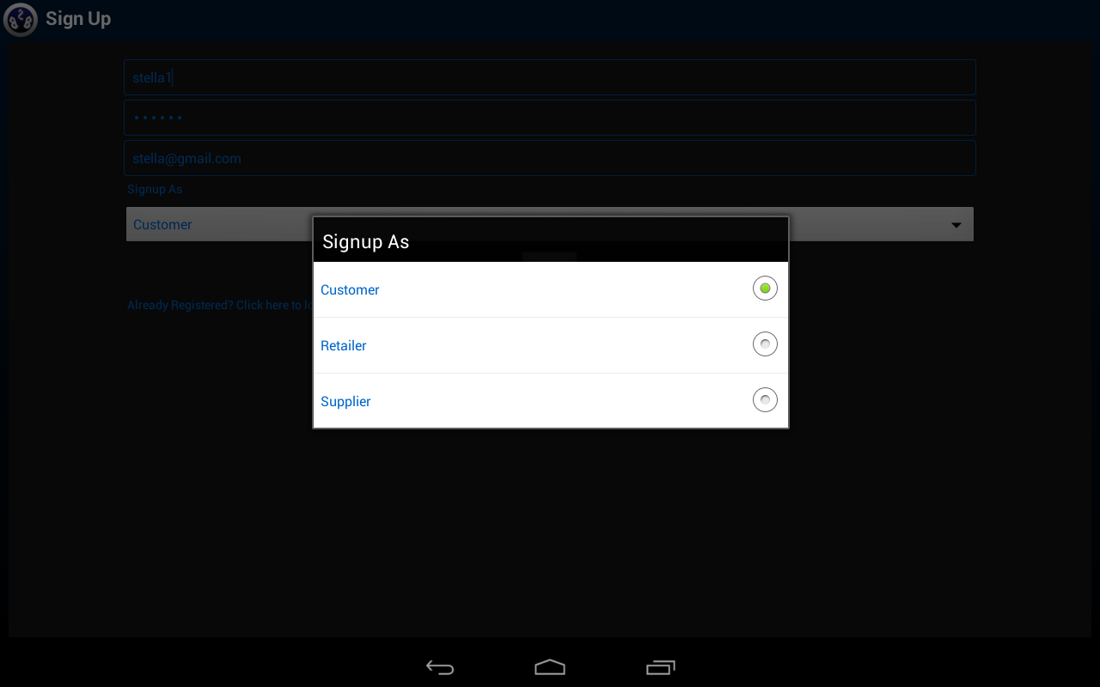
Registration Options

Slide 13
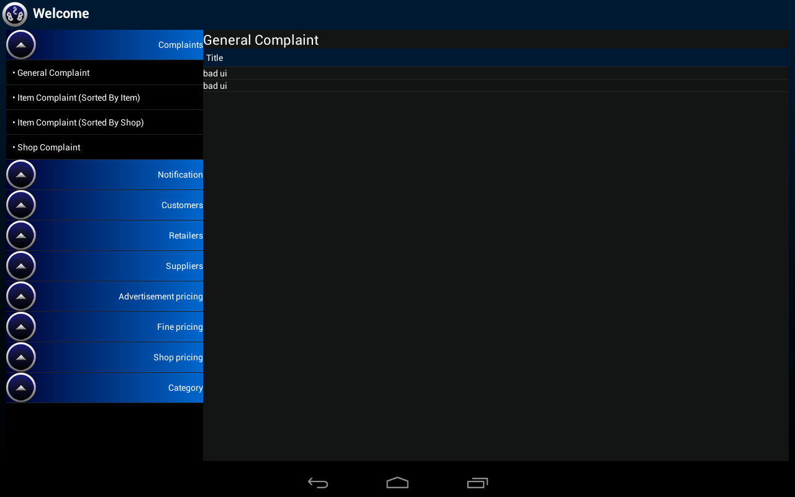
Admin Area- General Complaint

Slide 14
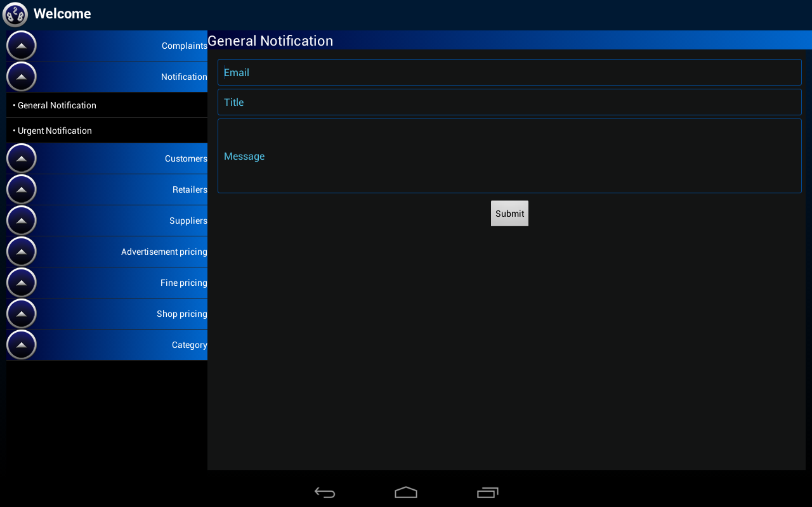
Admin Area- General Notification

Slide 15
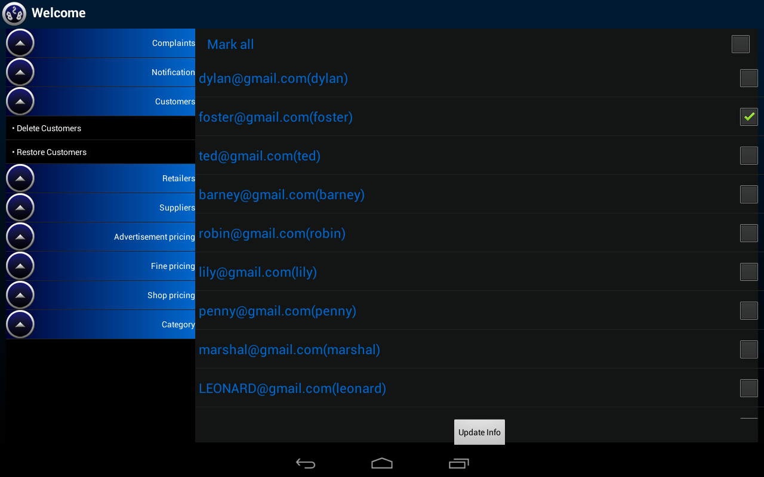
Delete Customer/Supplier/Retailer

Slide 16
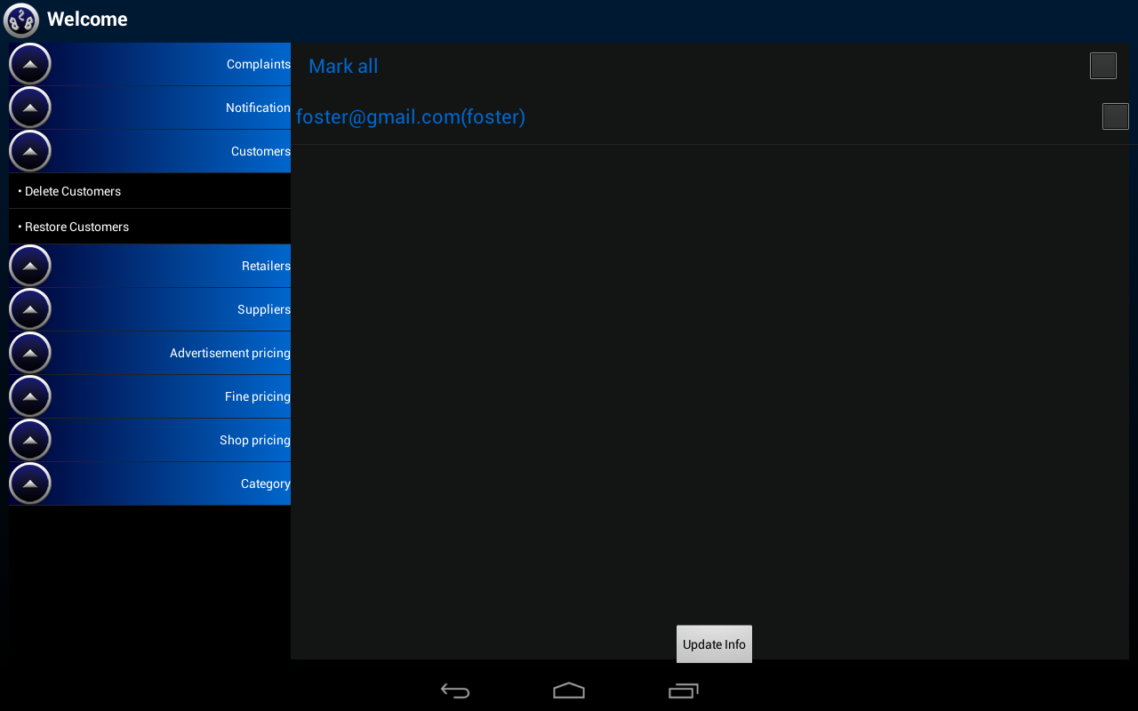
Restore customer/Supplier/Retailer

Slide 17
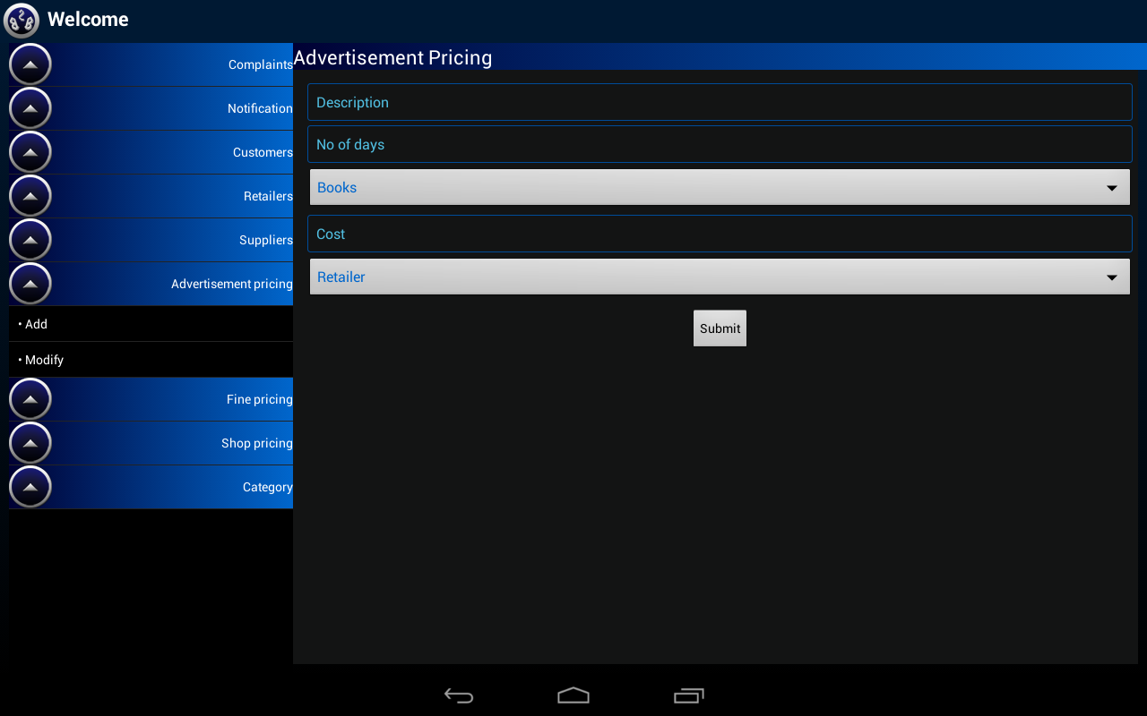
Advertisement Pricing

Slide 18
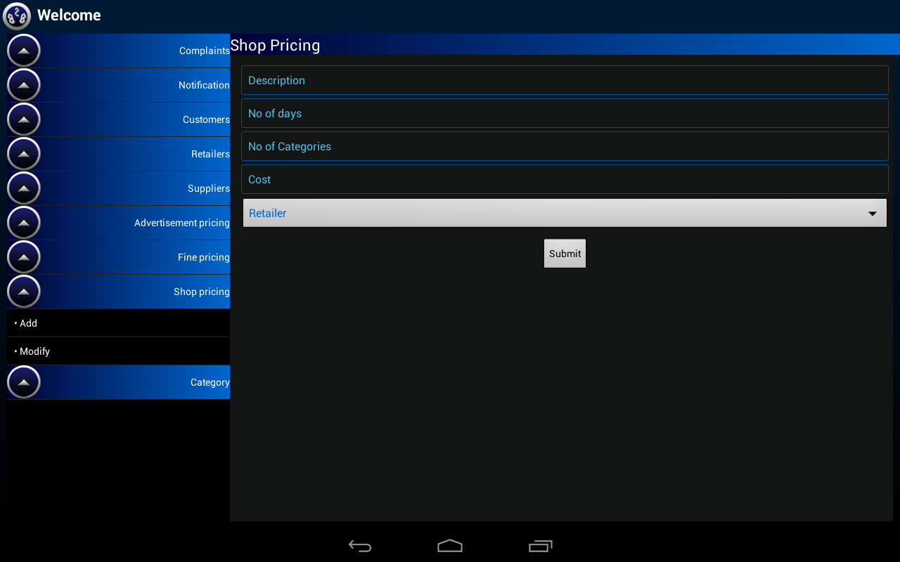
Shop Pricing

Slide 19
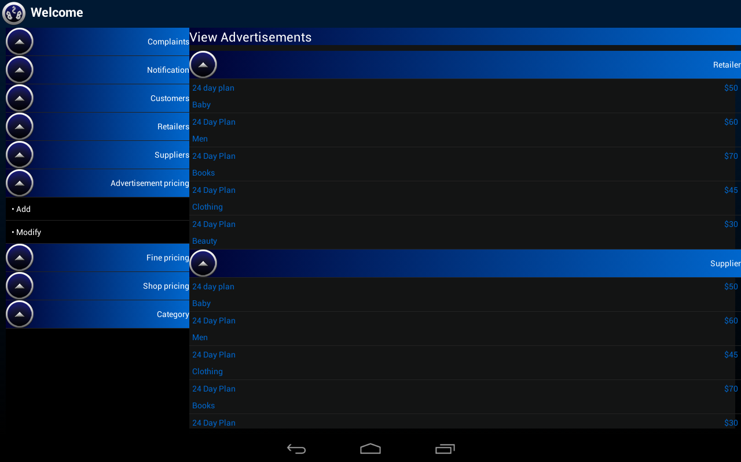
View Advertisement Pricing

Slide 20
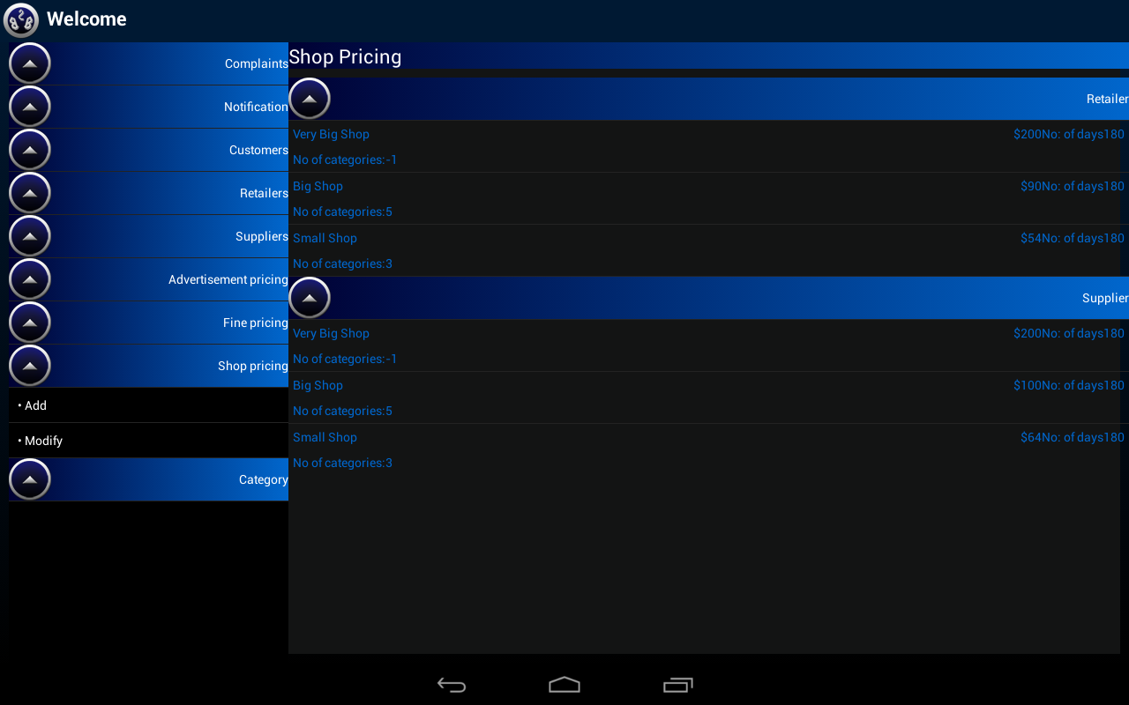
View Shop Pricing

Slide 21
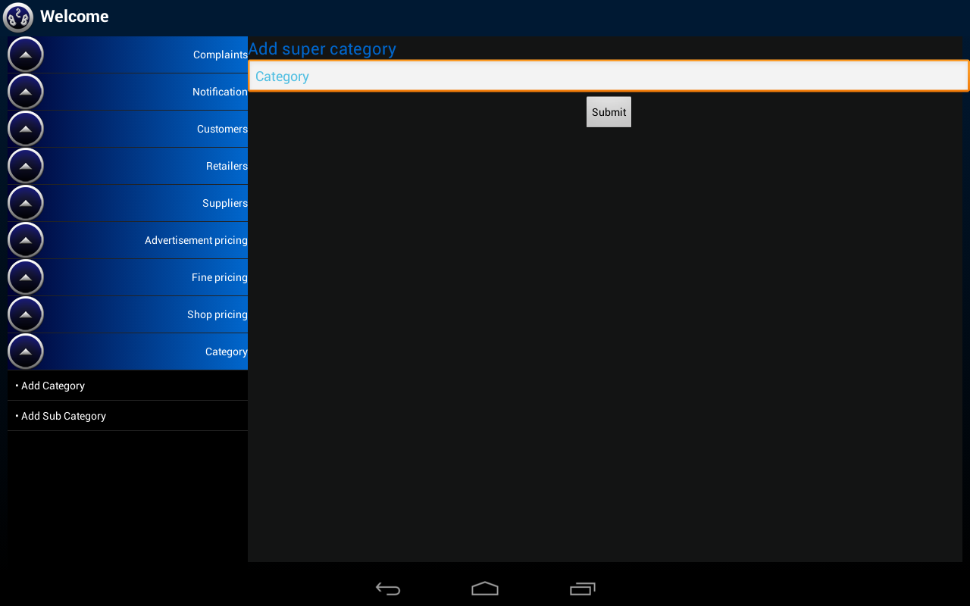
Add Super Category

Slide 22
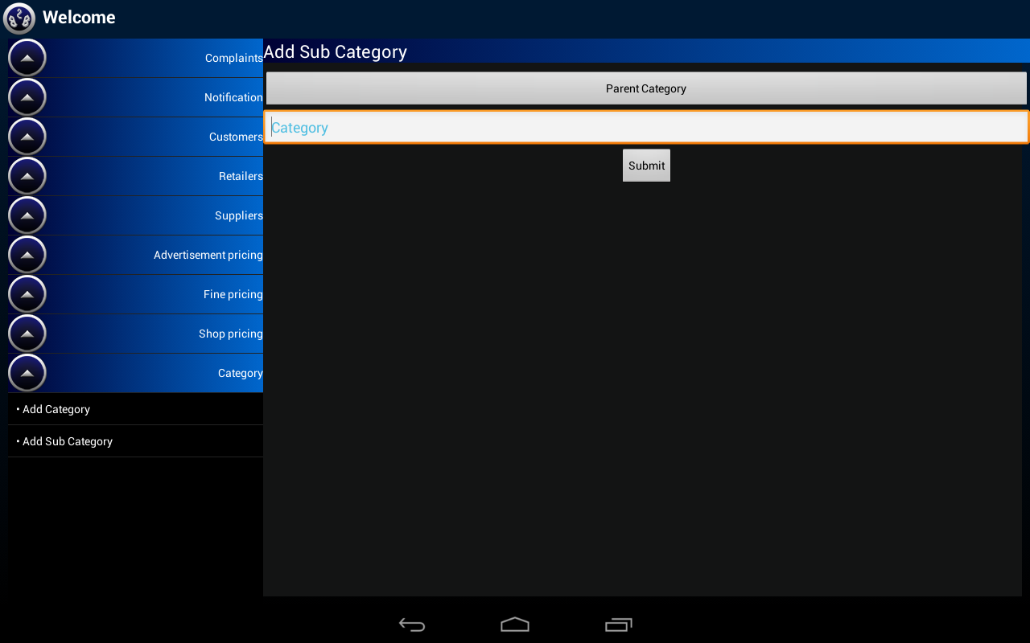
Add Sub category

Slide 23
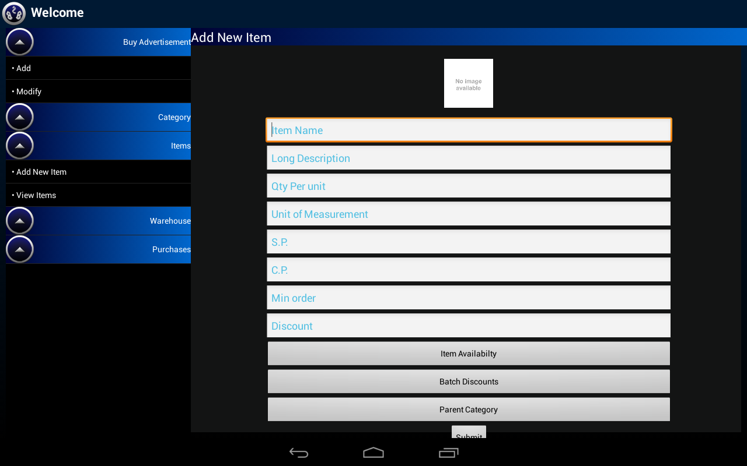
Add Item

Slide 24
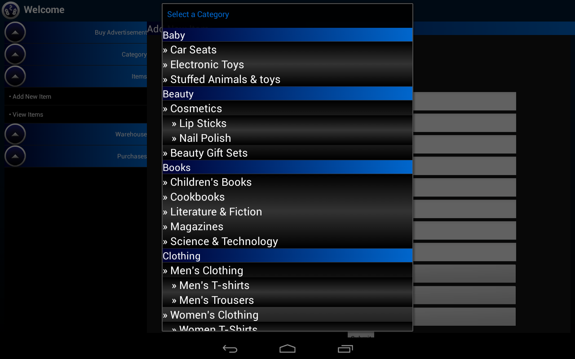
Add Item- Select a Category

Slide 25
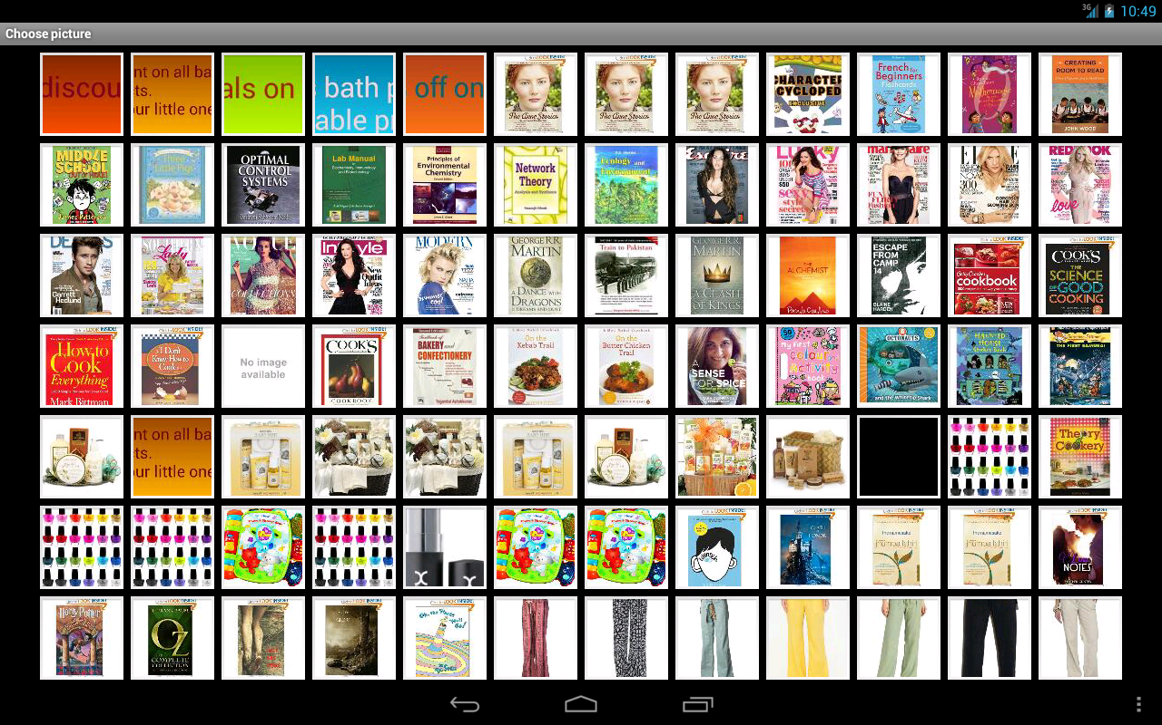
Add Item- Pick Image from gallery

Slide 26
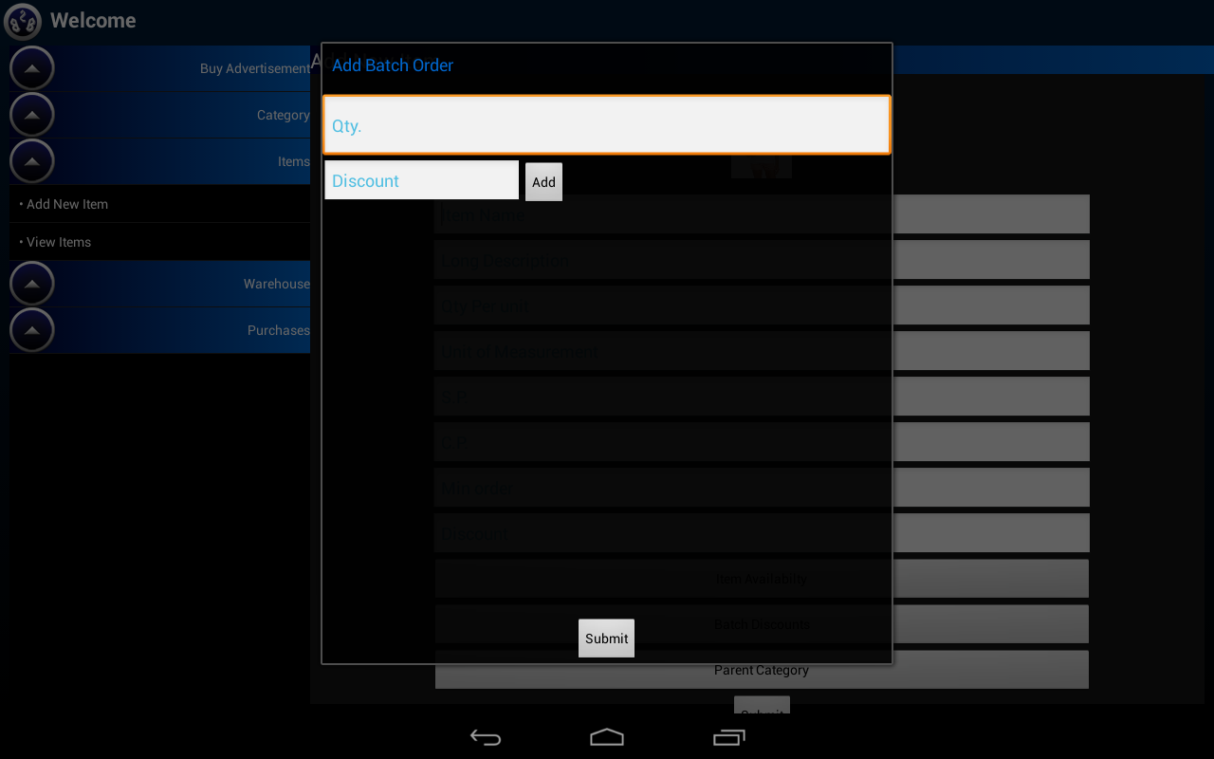
Add Item- Add batch discount

Slide 27
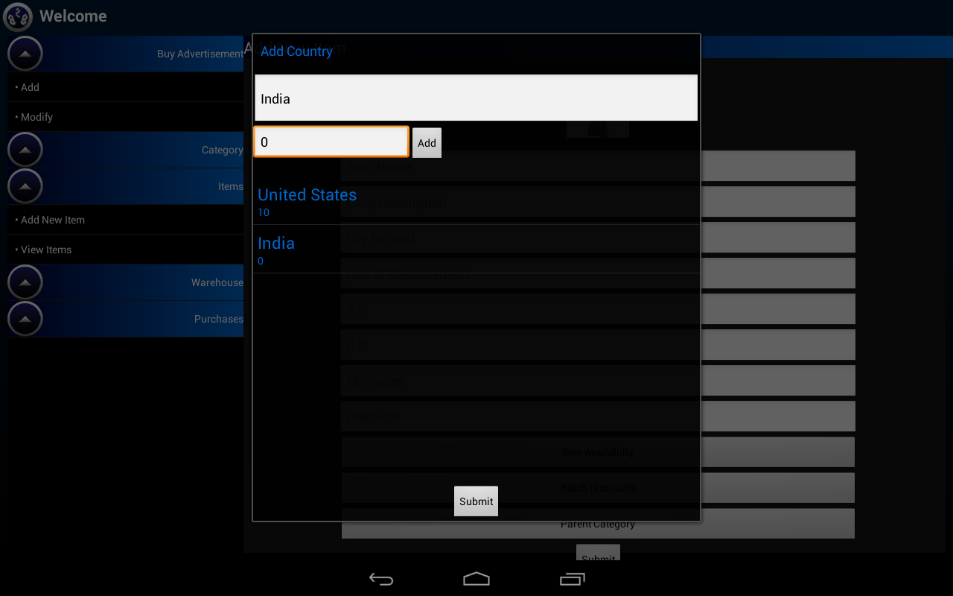
Add item- Add item availability

Slide 28
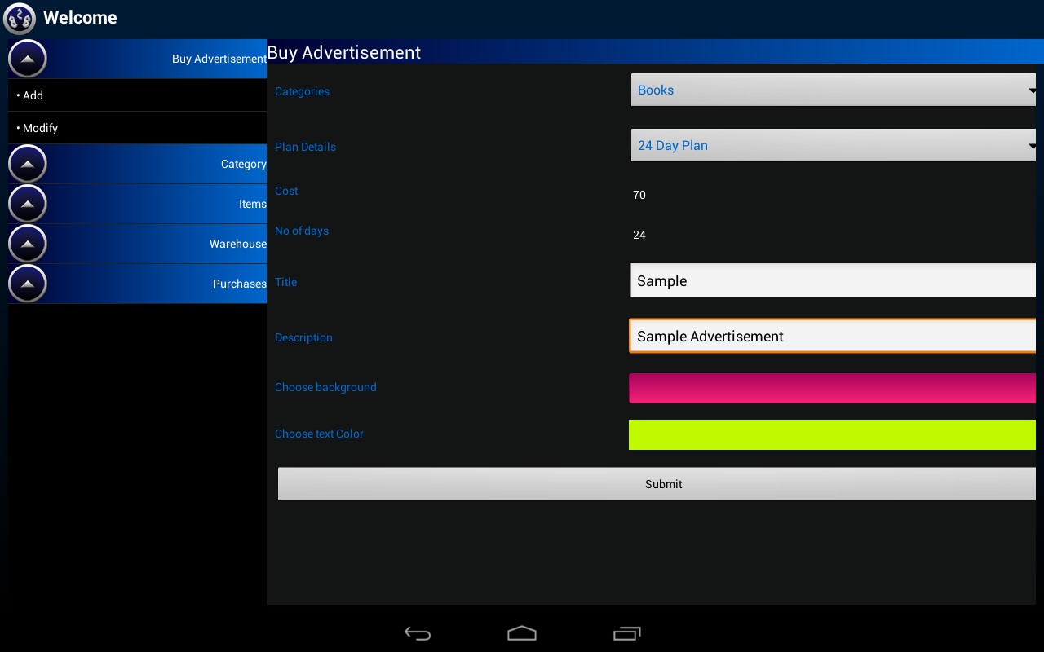
Add Advertisement

Slide 29
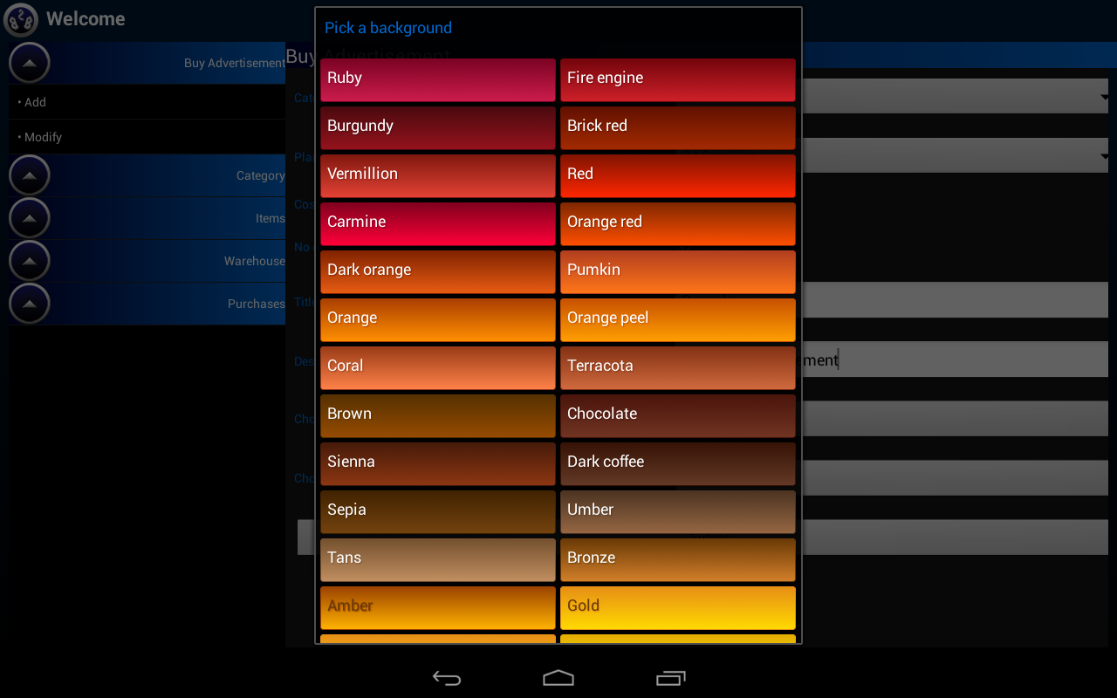
Add Advertisement- Pick a background

Slide 30
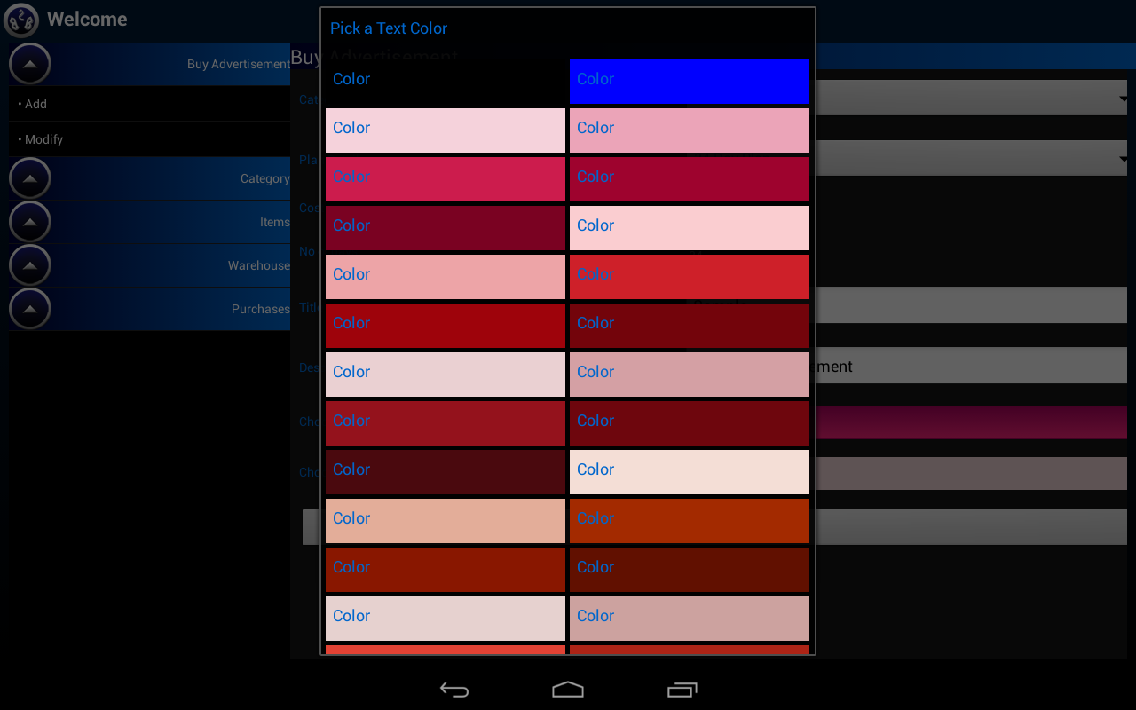
Add advertisement- Pick a text color

Slide 31
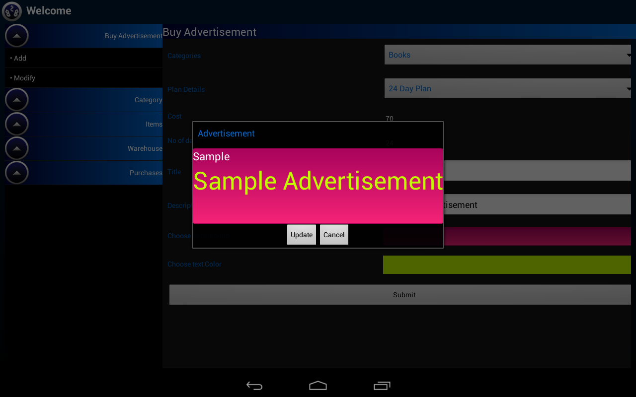
Preview Advertisement

Slide 32
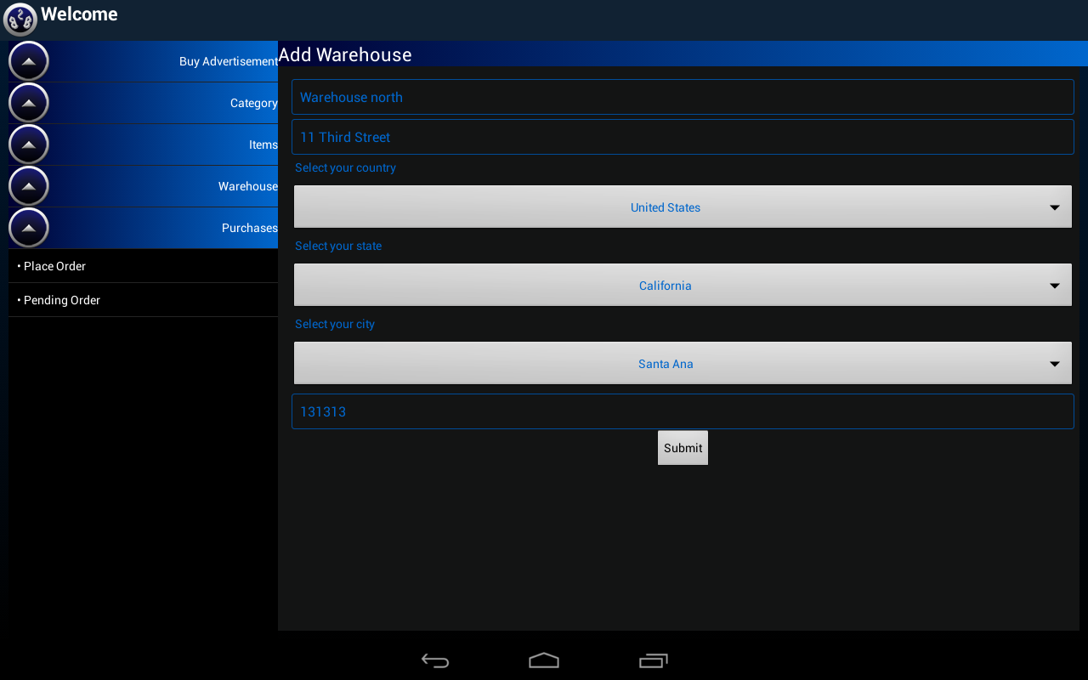
Add Warehouse

Slide 33
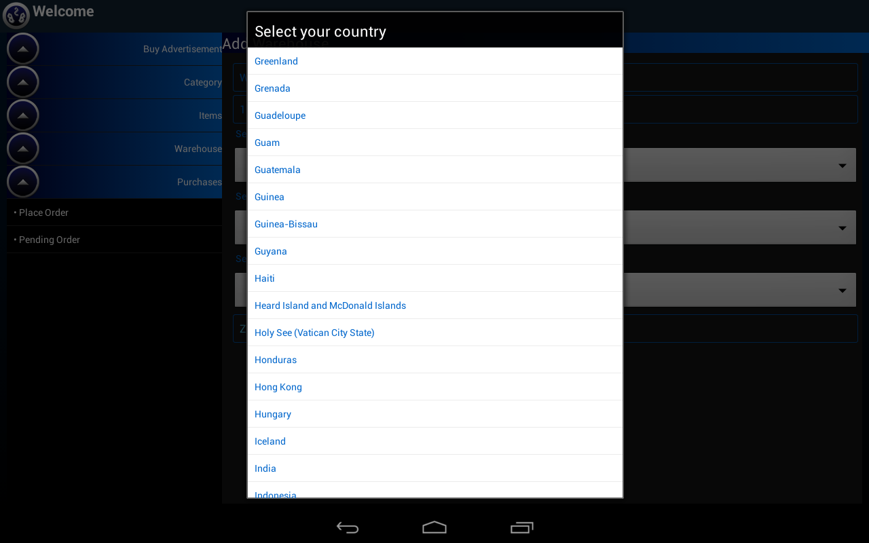
Add Warehouse- Select Country

Slide 34
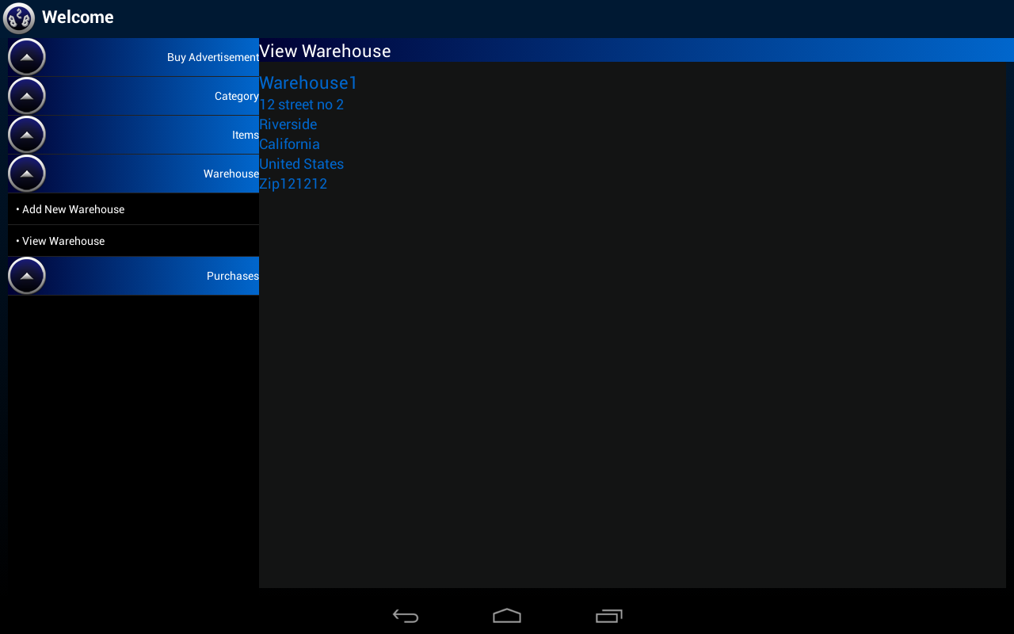
View Warehouse

Slide 35
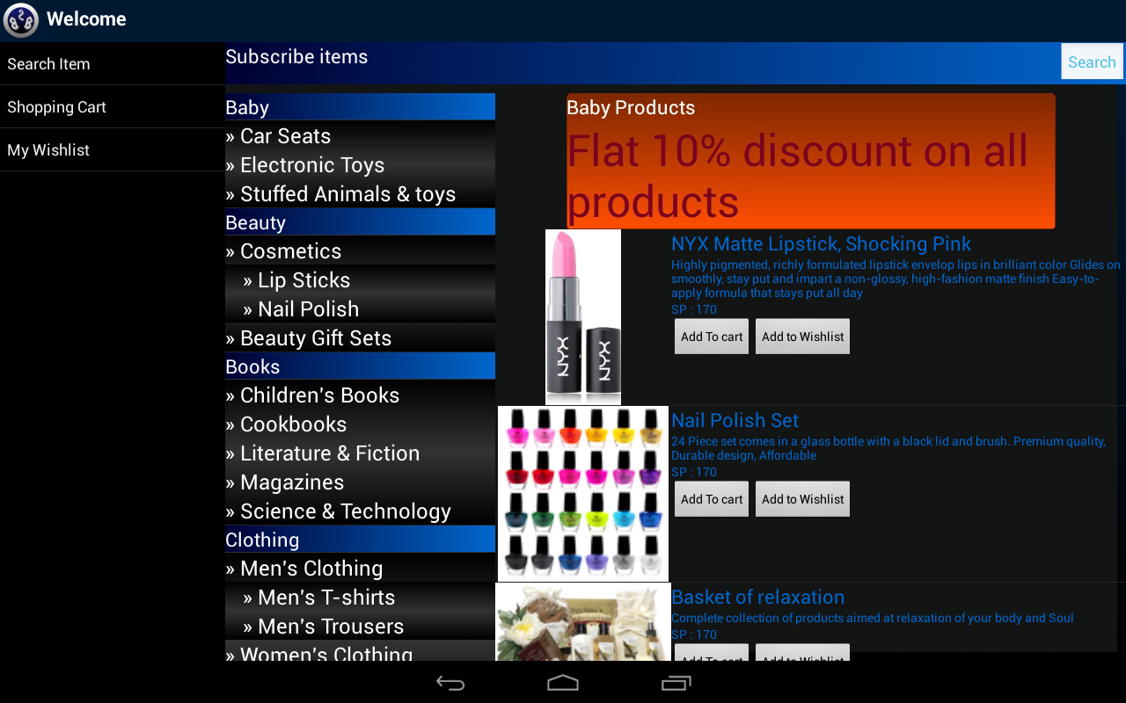
Customer Area

Slide 36
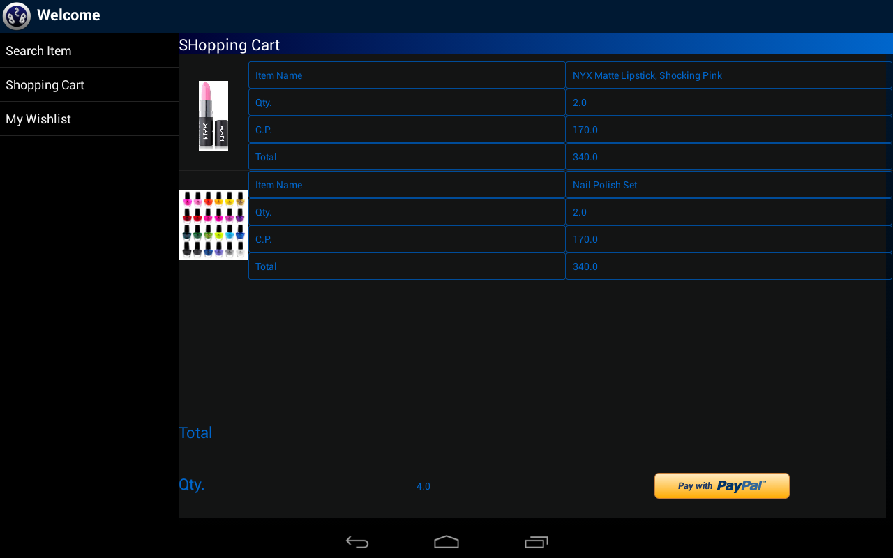
Shopping Cart

Slide 37
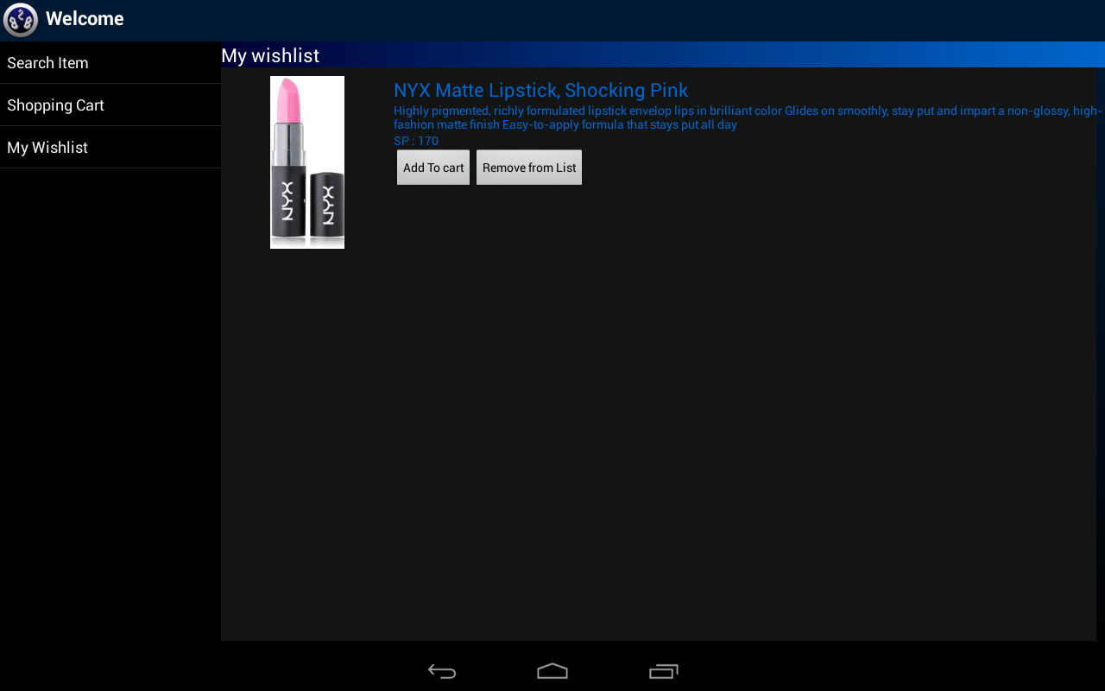
Wishlist

Slide 38
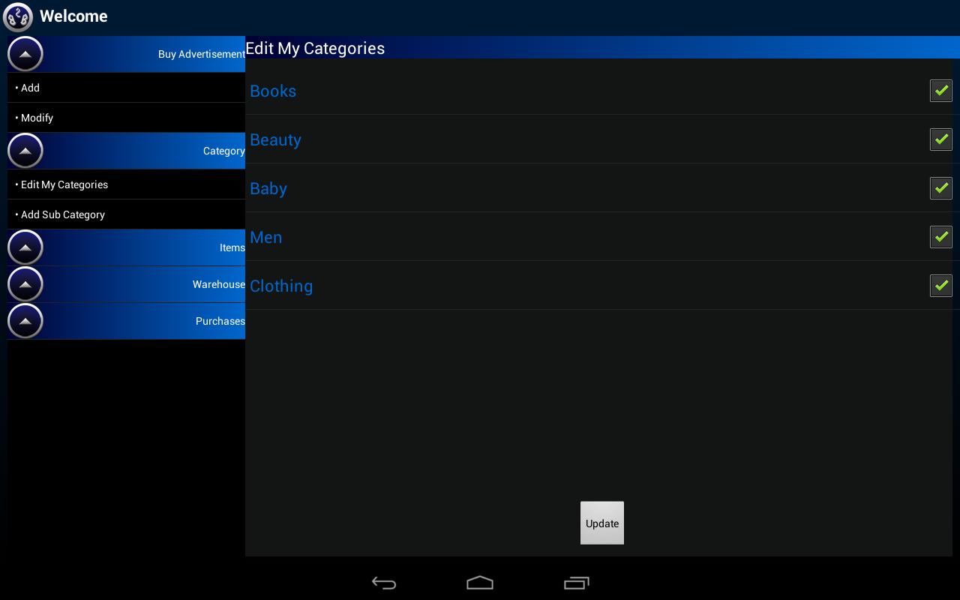
Edit My Categories

Slide 39
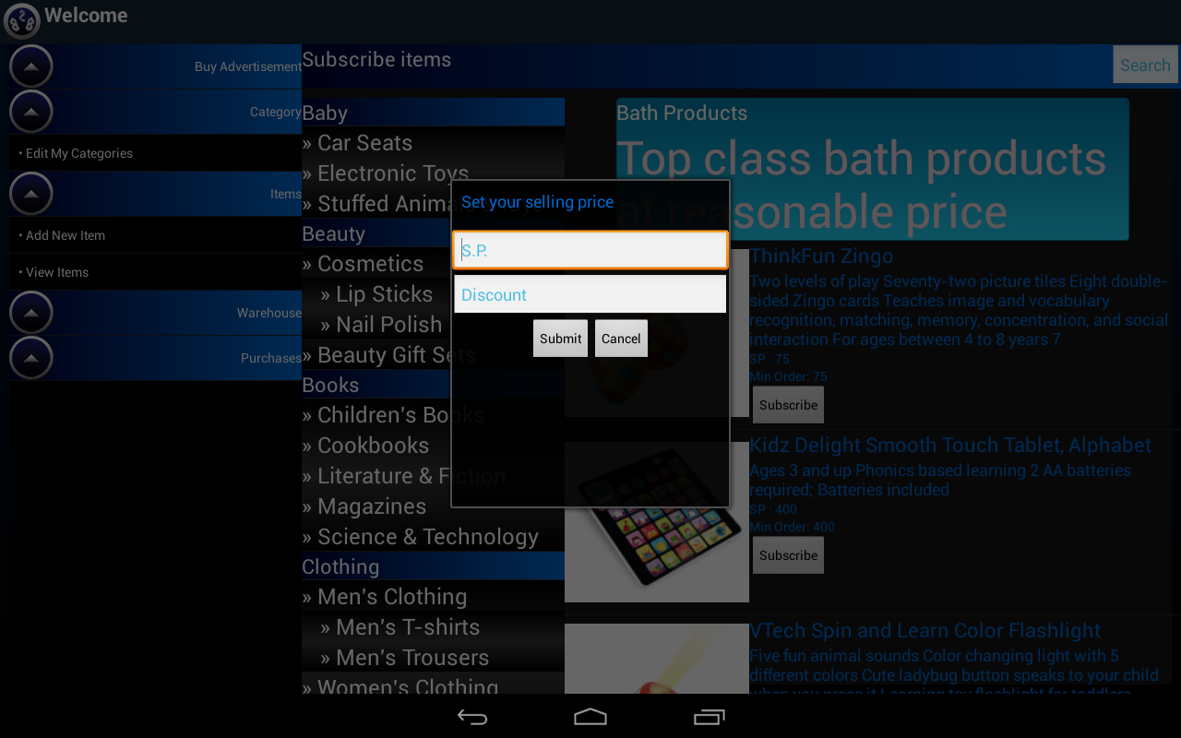
Subscribe Items

Slide 40
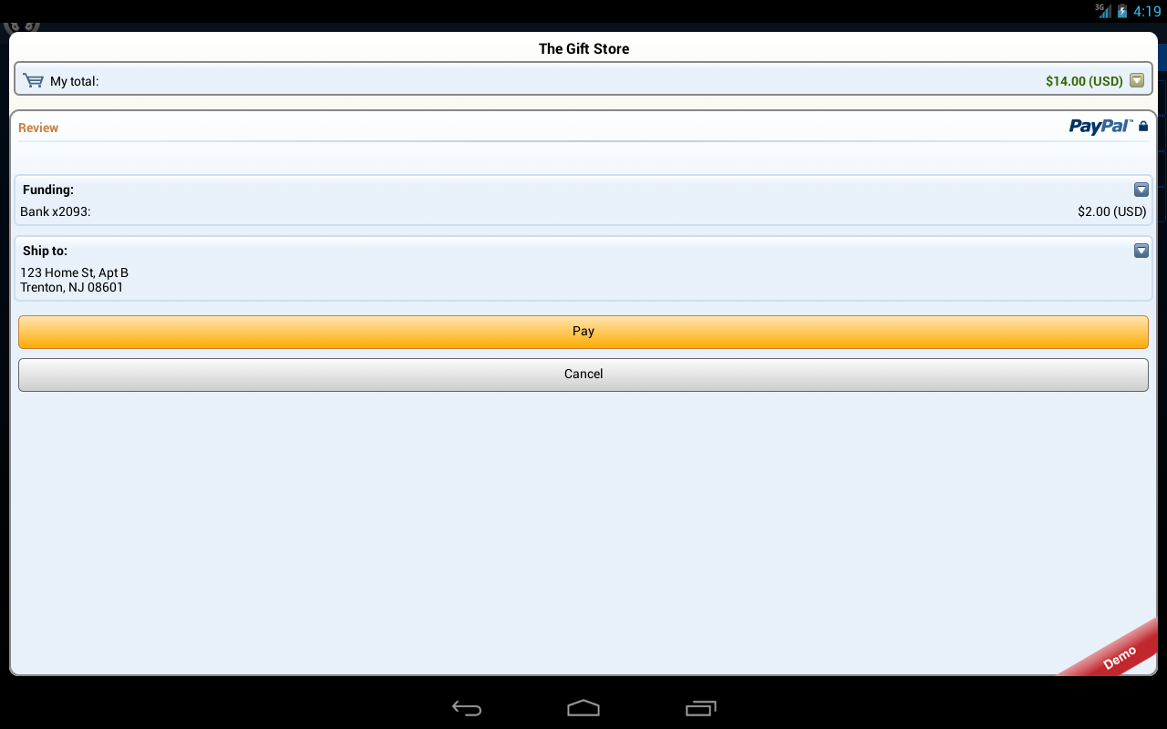
PayPal Payment

Slide 41
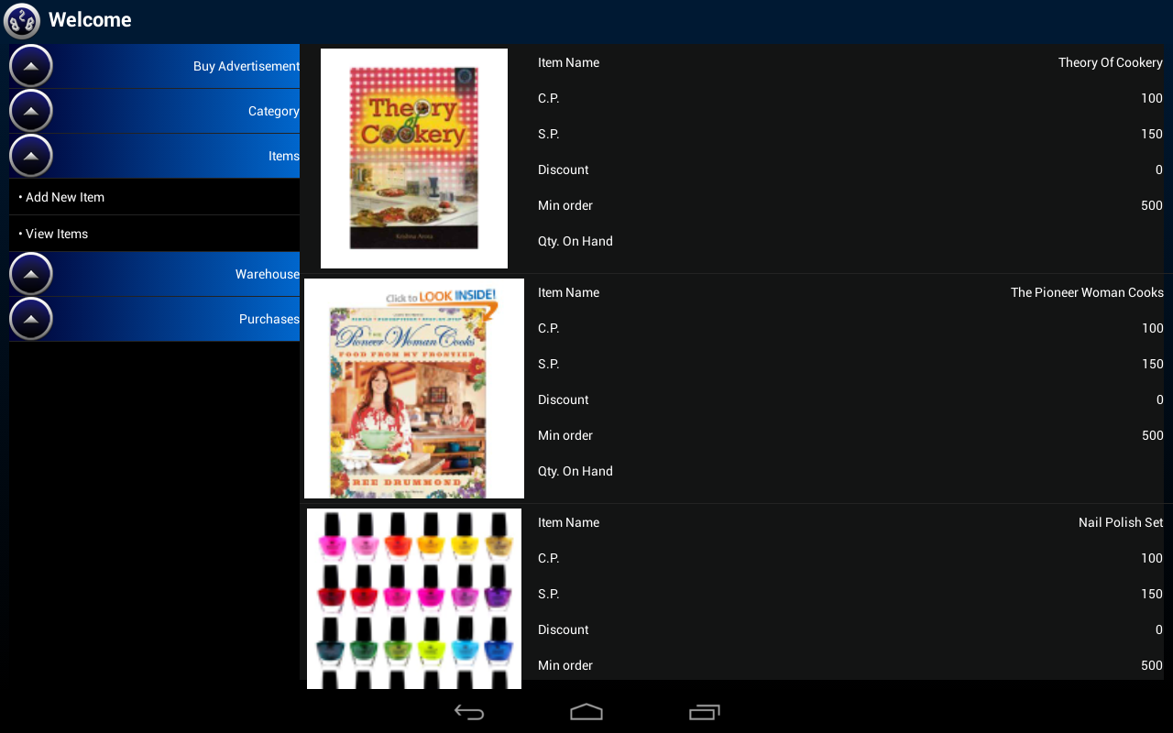
My Items

Slide 42
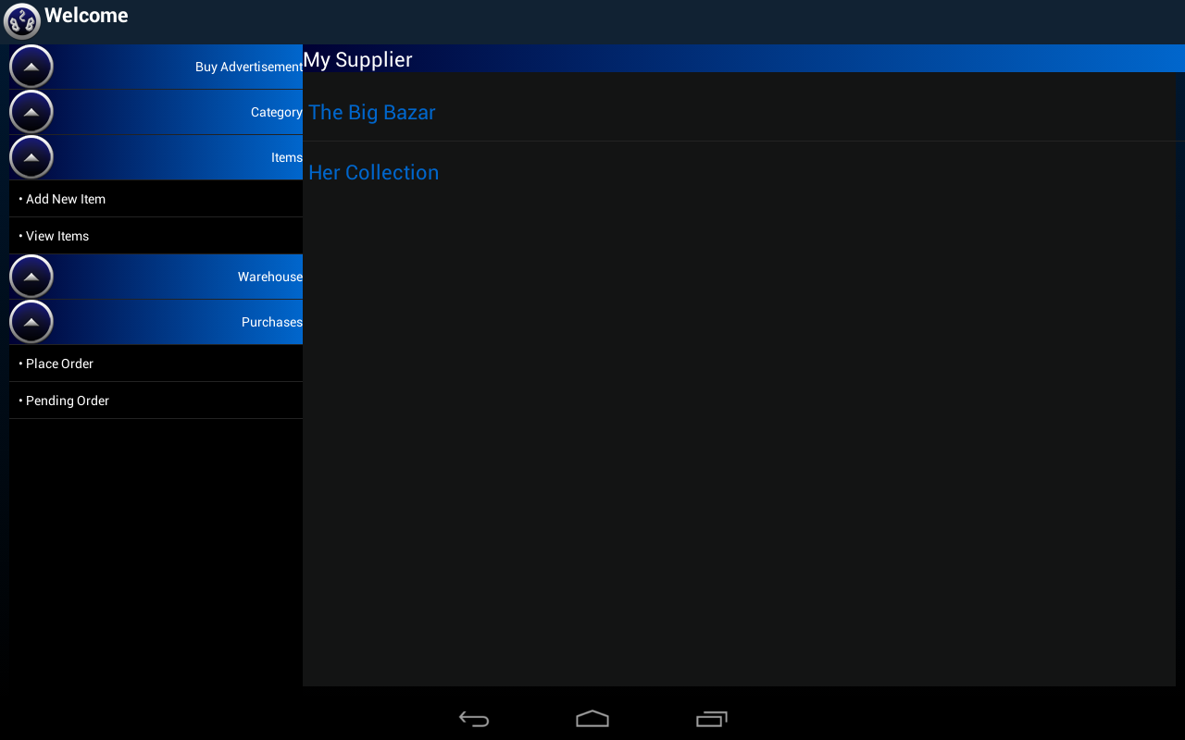
My Suppliers

Slide 43
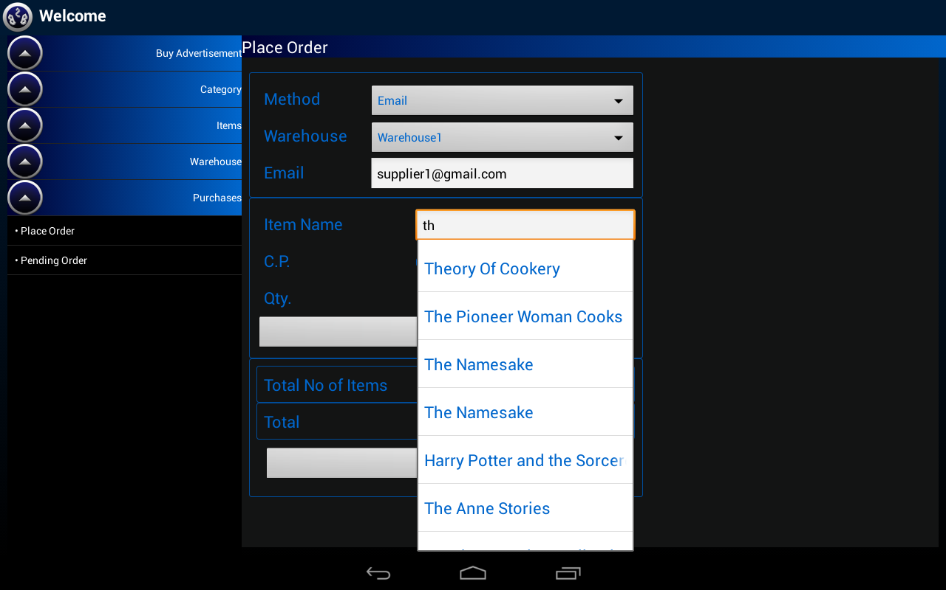
Place order- Supplier

Slide 44
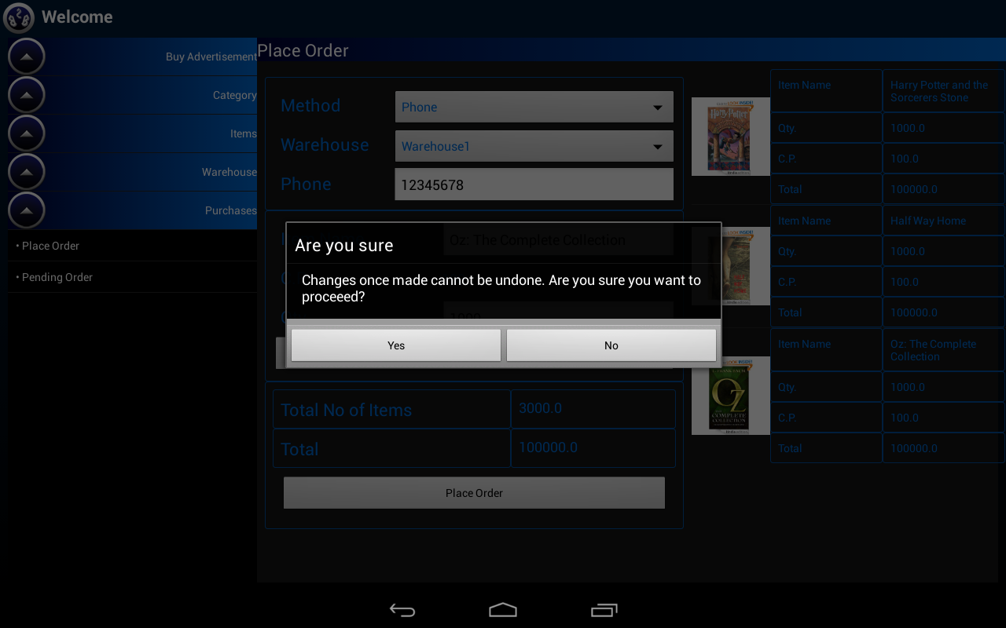
Place order- Confirm

Slide 45
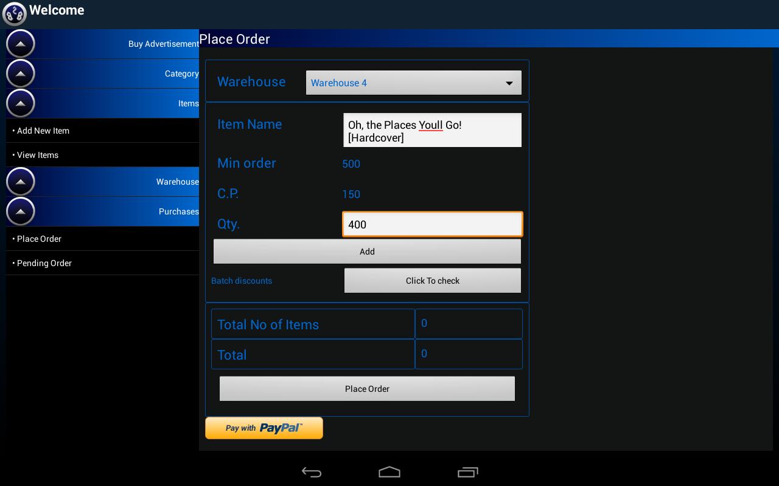
Place Order Retailer

Slide 46
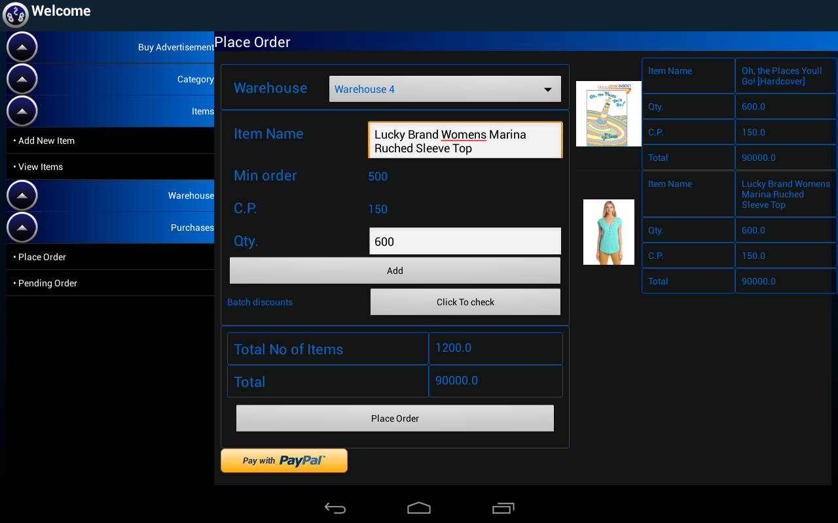
Place order retailer

Slide 47
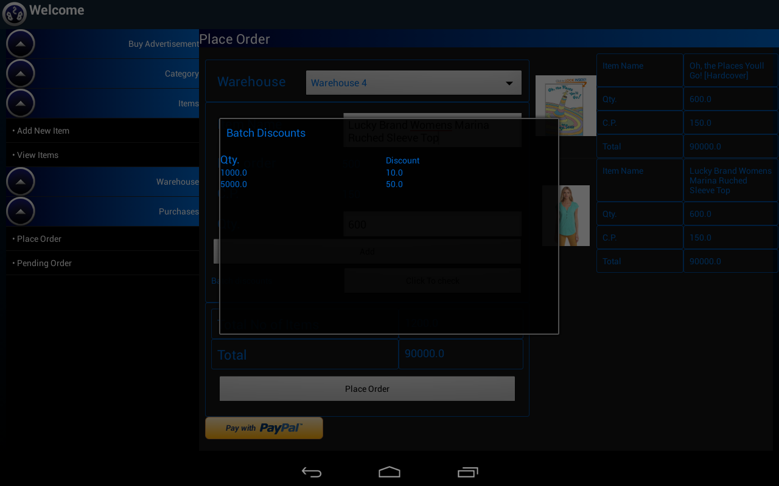
View Batch Discount

Slide 48
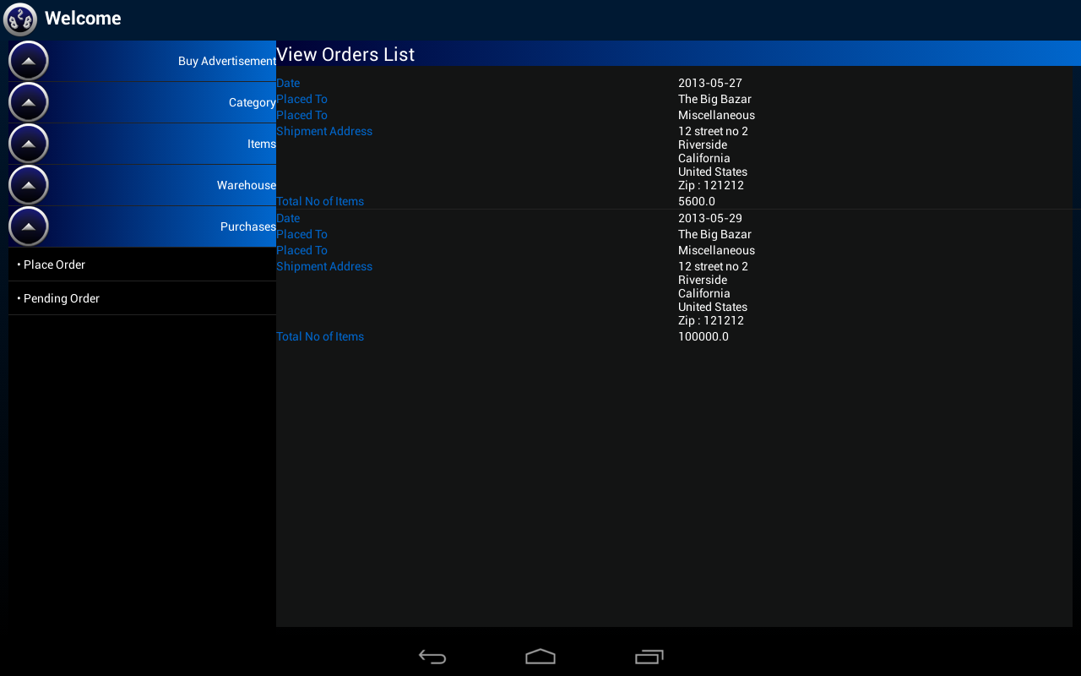
View Order List

Slide 49
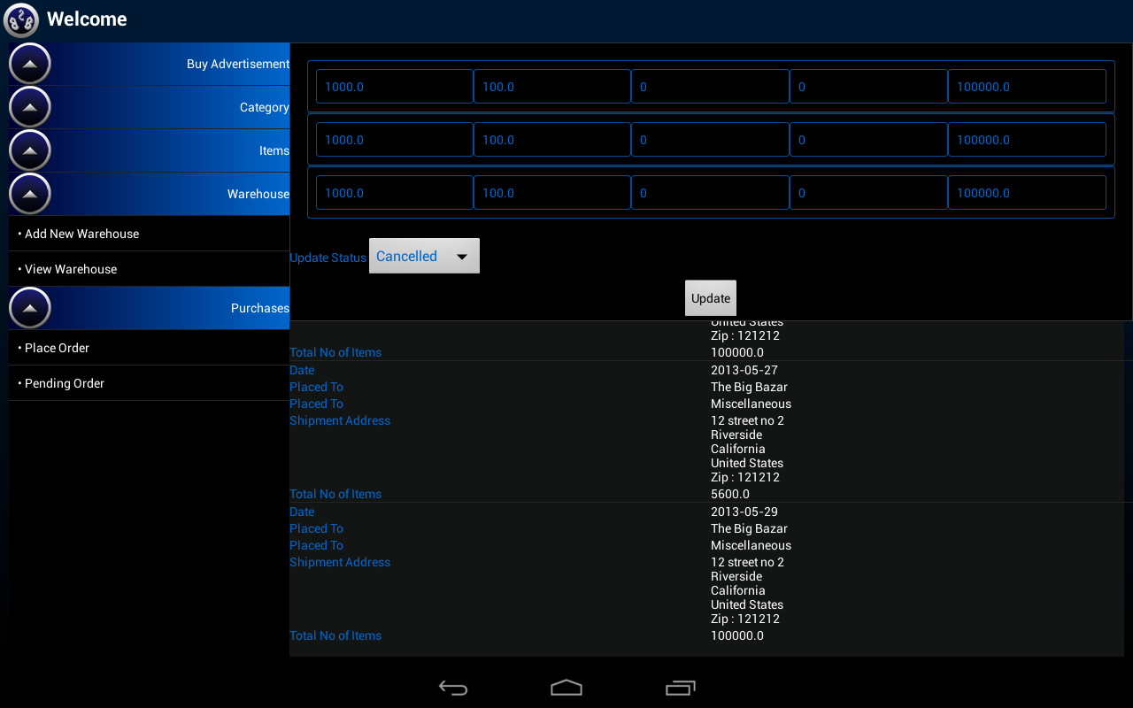
View Order List Detail

Slide 50
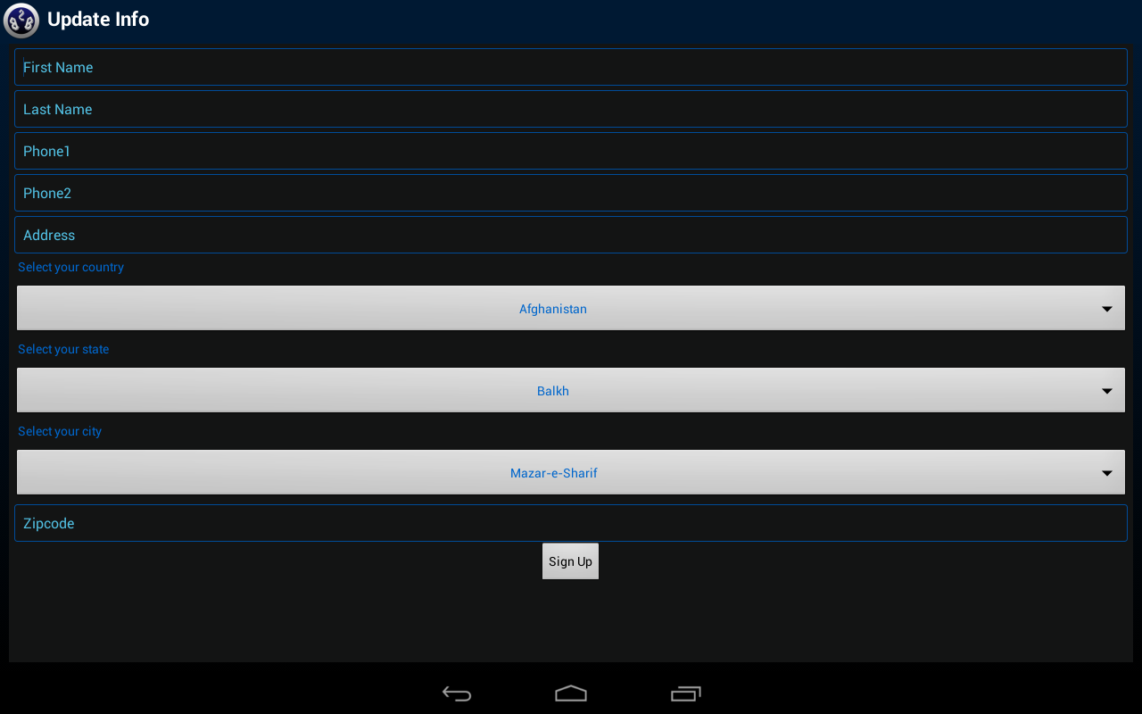
Update Information

Slide 51
Thank You

